Slide 1
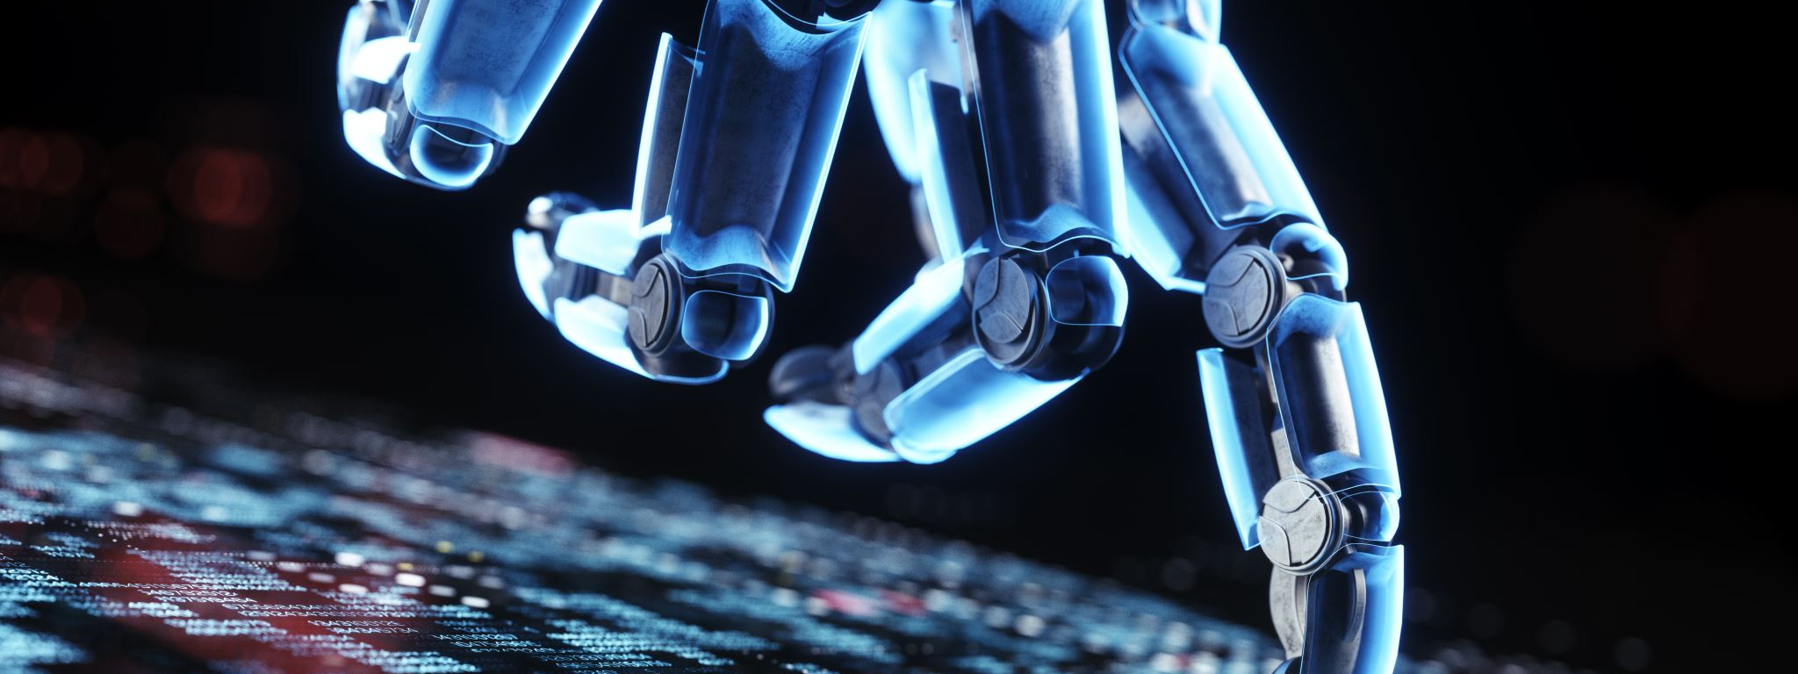
Introduction to AI Chatbots
AI chatbots are software applications that use artificial intelligence to mimic human conversation. They're used in customer service, e-commerce, healthcare, and more.

Slide 2

Applications of AI Chatbots
Customer Service: Automating responses.
E-commerce: Assisting in product searches.
Healthcare: Providing initial medical advice.

Slide 3

What are Large Language Models (LLMs)?
LLMs like GPT can understand and generate human language by processing vast amounts of text data, used for essays, translating languages, etc.

Slide 4
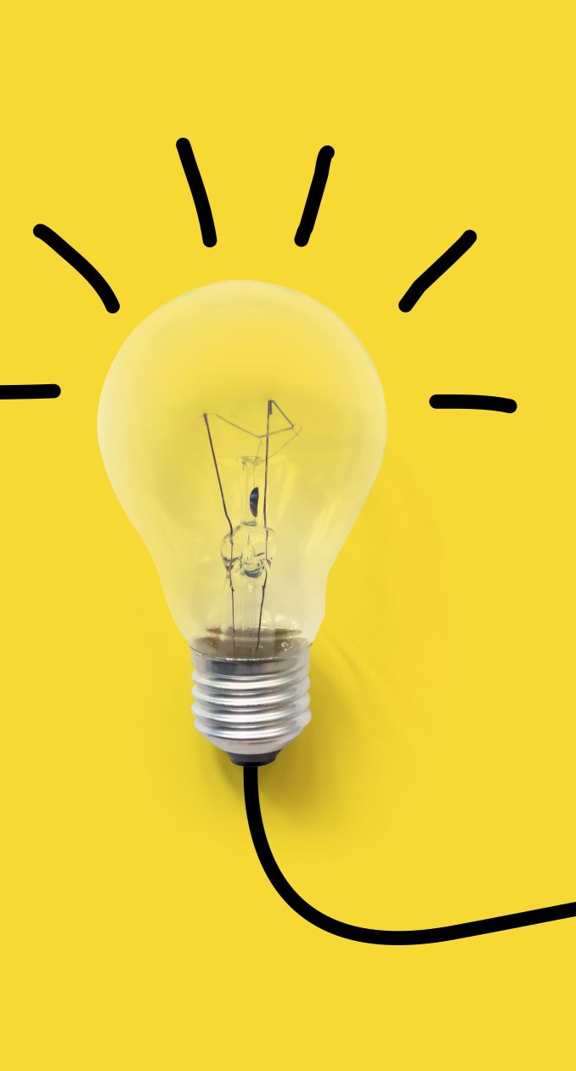
What are AI Agents?
Systems capable of autonomous actions to meet objectives. They learn from interactions and make decisions, used in personal assistants, autonomous vehicles.

Slide 5
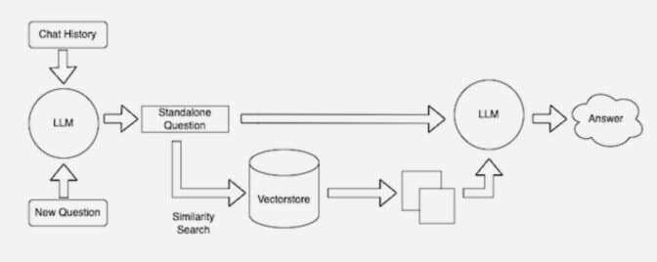
What is a RAG Model?
Combines retrieval-based and generative models for tasks like question answering. Retrieves information from a database, then generates a response.
https://blogs.nvidia.com/blog/what-is-retrieval-augmented-generation/

Slide 6

Integrating AI in Chatbots
LLMs for natural language understanding, AI agents for decision-making, and RAG models for utilizing external knowledge bases in chatbot development.

Slide 7
Get Gemini API Key
ai.google.dev
Get the API Key
Clone my repo:
https://github.com/muhammad-mobeen/AI-Bootcamp-Gemini-Chatbot-Training

Slide 8

Let’s get the hands dirty now!

